Slide 1
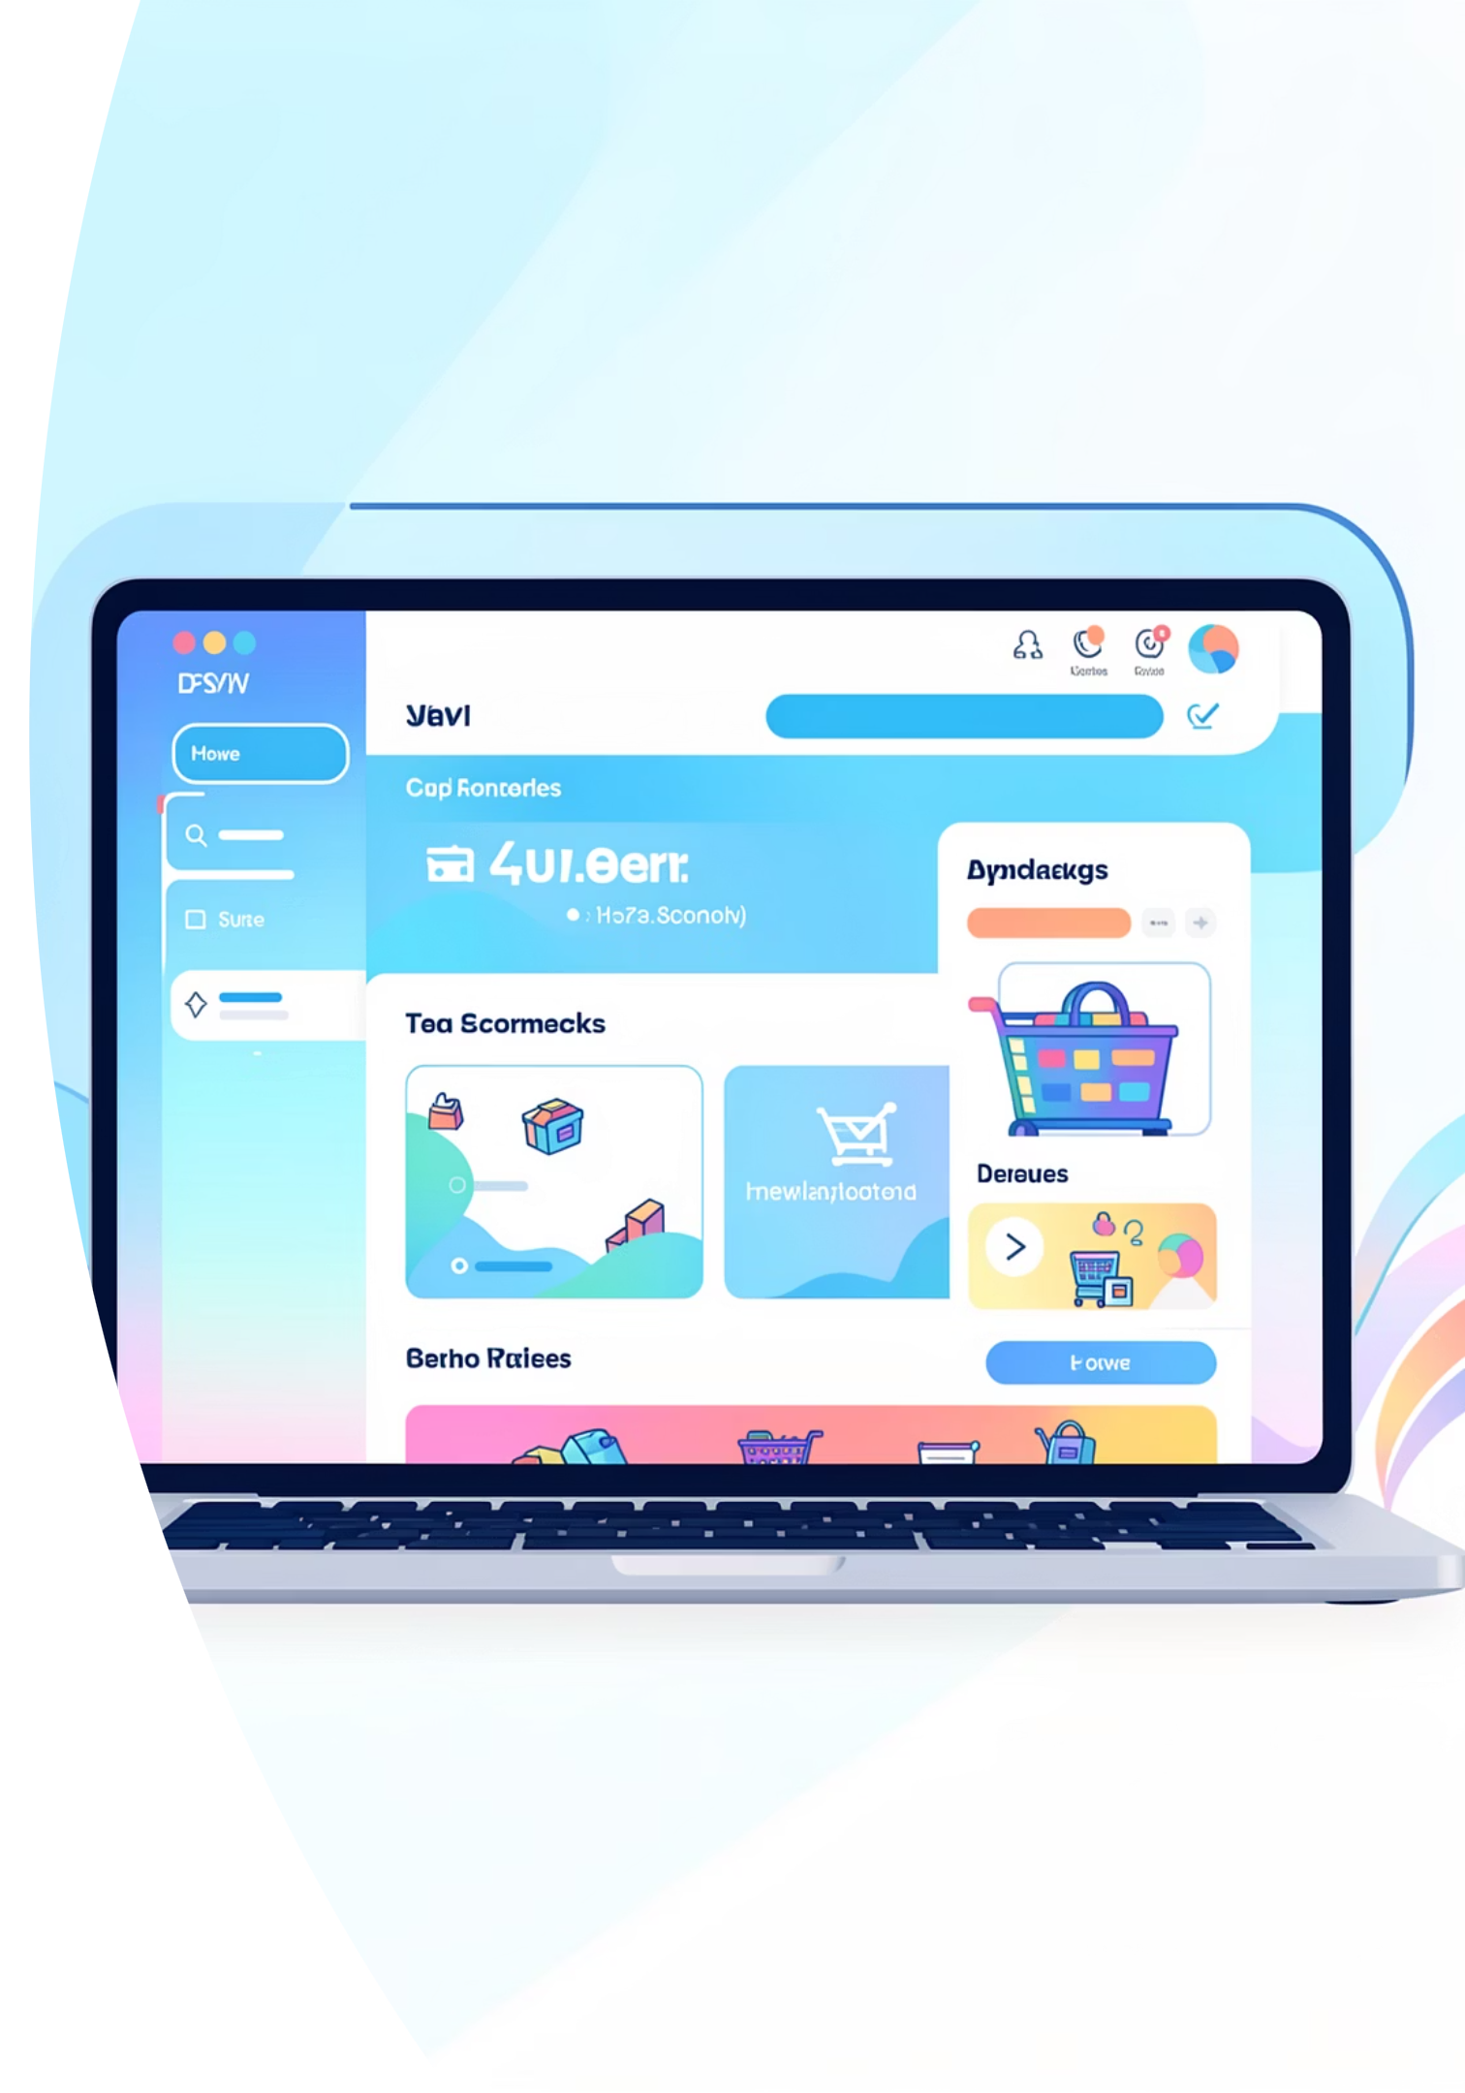
E-Shop
A Modern Full-Stack E-Commerce Application

Slide 2

Final Project Overview
Project Purpose
Stack Used
Built a complete e-commerce platform using modern web technologies, demonstrating full-stack development capabilities from database design to responsive frontend implementation.
Implementation showcases proficiency in both backend and frontend development with secure authentication, RESTful API design, and responsive user interfaces.

Slide 3
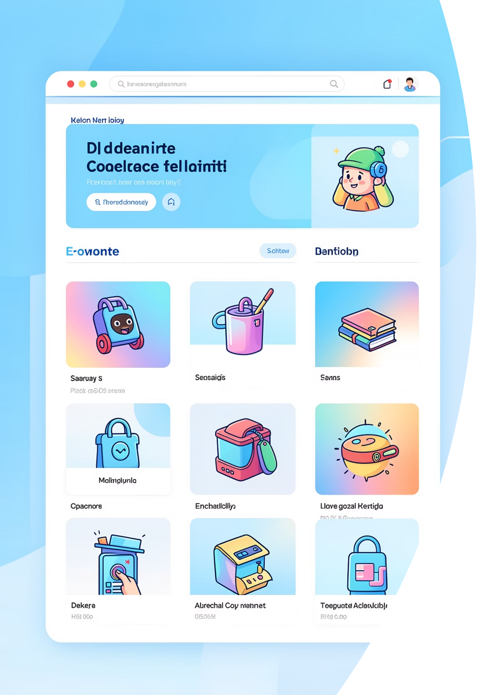




What is E-Shop?
Online Marketplace
Secure Platform
A fully functional e-commerce platform allowing users to browse, search, and purchase products with secure transactions
JWT-based authentication and encrypted passwords ensure user data protection throughout the shopping experience
Responsive Design
Seamless experience across desktop, tablet, and mobile devices with adaptive layouts and touch-friendly interface

Slide 4

Live Demo & Features
Explore E-Shop
Frontend: E-Shop
Backend API: Link
Key Features
Secure user authentication with JWT tokens
Browse products with filtering and search
Shopping cart with quantity management
Order history and tracking

Slide 5


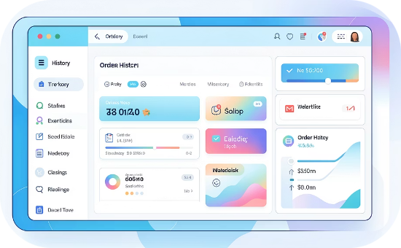
Core User Features
Secure Authentication
Shopping Cart
Order Management
Complete cart management allowing users to add, remove, and update product quantities
Users can place orders and access complete order history with tracking information
Built-in signup and login functionality with JWT token management for session handling
Real-time quantity updates
Price calculations
Order status tracking
Transaction history
BCrypt password encryption
Token refresh mechanisms

Slide 6
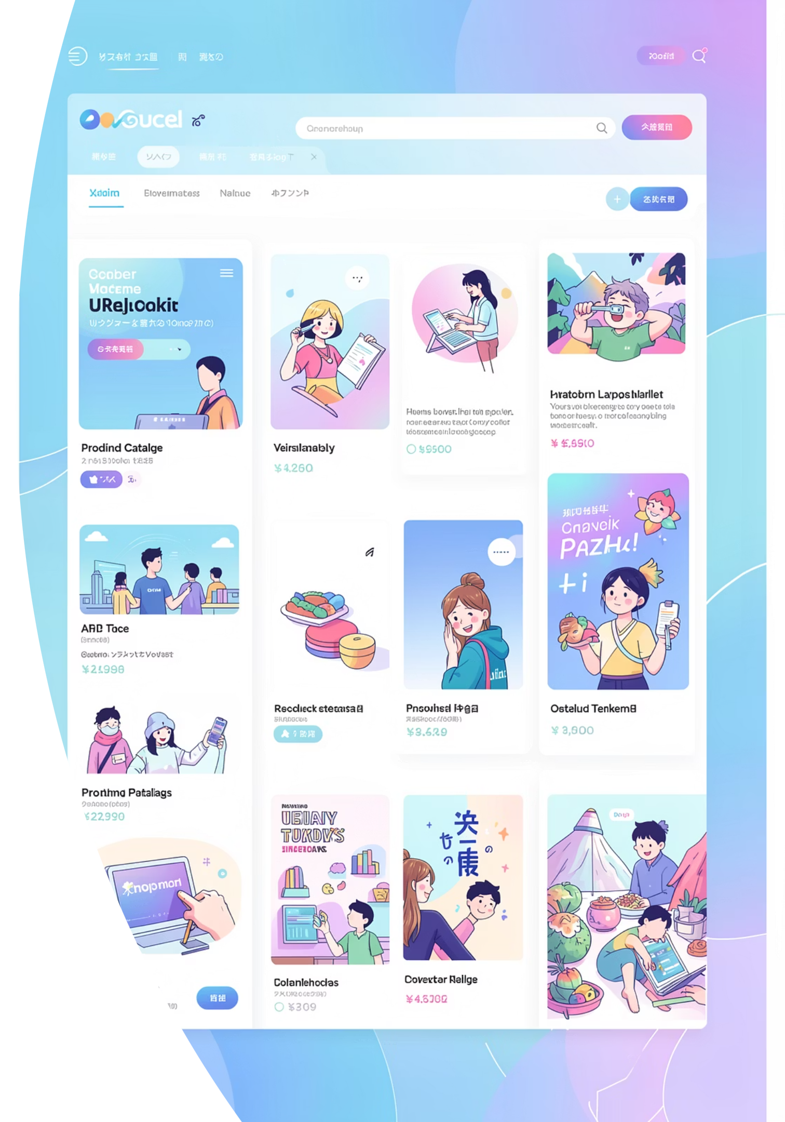

Product Catalog Features
1
Advanced Filtering
Filter products by category, price range, and other attributes to find exactly what you need
2
Smart Search
Keyword-based search functionality that searches product names, descriptions, and categories
3
Flexible Sorting
Sort results by price (ascending or descending), newest arrivals, or relevance to search
4
Detailed Views
Comprehensive product detail pages showing images, descriptions, pricing, and specifications

Slide 7
Technology Stack
Backend Architecture
Node.js & Express.js
MongoDB & Mongoose
Server-side runtime and web application framework for handling HTTP requests and routing
NoSQL database with object modeling for efficient data storage and retrieval operations
Authentication
API & CORS
JWT tokens for secure session management and BCrypt for password encryption implementation
RESTful endpoints with cross-origin resource sharing for secure frontend-backend communication

Slide 8
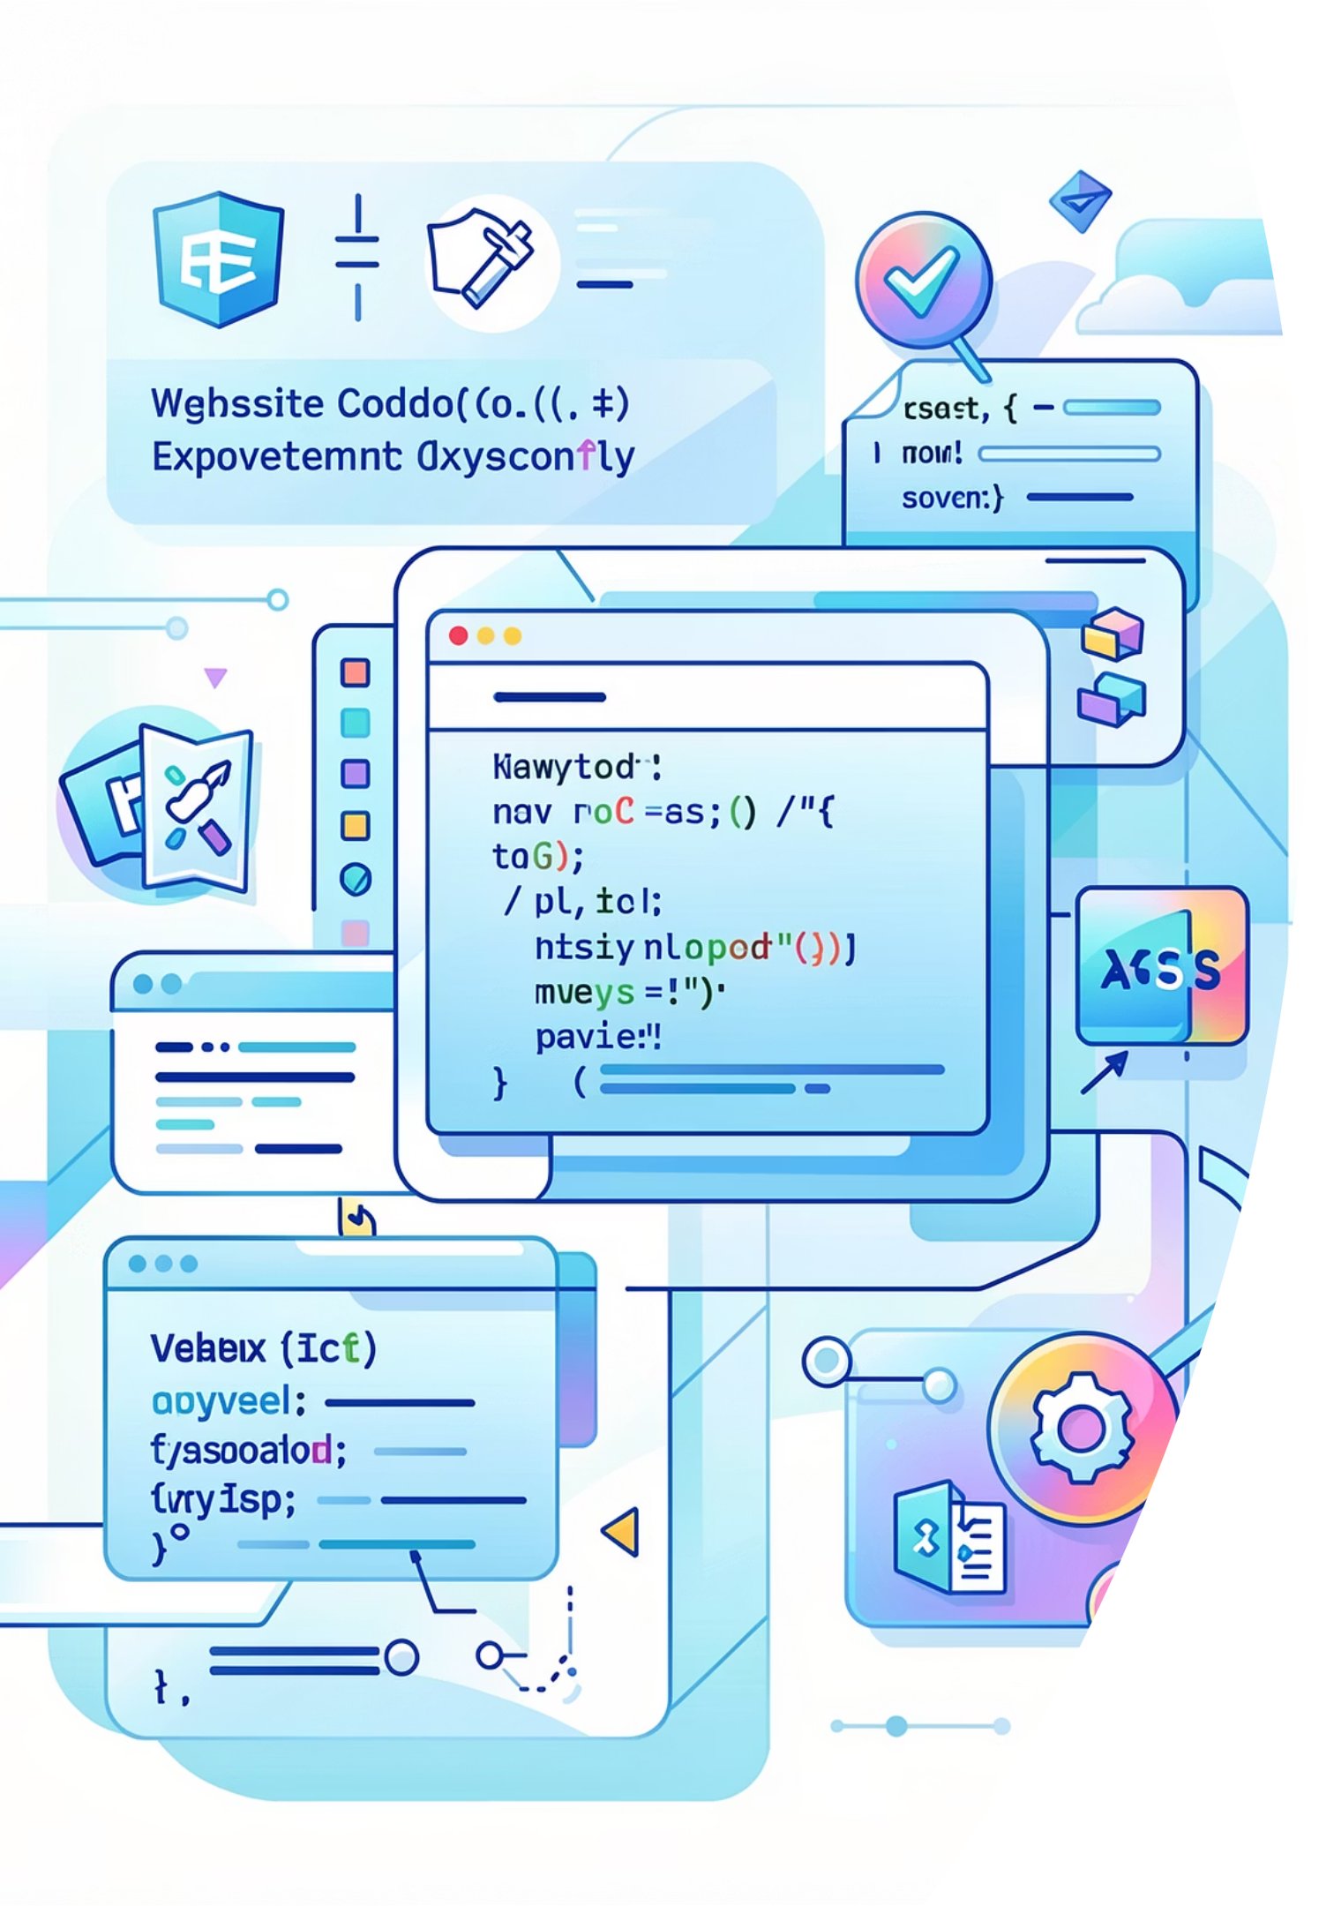
Technology Stack
Frontend Implementation
HTML5/CSS3
Semantic structure with modern styling techniques and animation support
Vanilla JavaScript
Core functionality implementation without frameworks for direct DOM manipulation
Axios
Promised-based HTTP client for making API requests to backend endpoints
CSS Grid & Flexbox
Responsive layout design ensuring consistency across different screen sizes and devices

Slide 9

Key Technical Features
JWT Authentication System
Stateless, token-based authentication using JSON Web Tokens for secure user sessions with proper token validation, refresh logic, and session management
BCrypt Password Hashing
Industry-standard password encryption using BCrypt algorithm to protect user credentials with salt generation and secure comparison functions
RESTful API Endpoints
Well-structured, consistent API design with clear separation of concerns, standardized response formats, and proper HTTP status codes for all operations
MongoDB Integration
Schema-based data modeling with Mongoose ODM, efficient queries, indexing strategies, and relationship management between collections

Slide 10


Project Key Takeaways
Key Learnings
Enhanced understanding of full-stack development principles, including API design patterns and database optimization techniques
Skills Demonstrated
Full-stack development proficiency
RESTful API architecture
JWT authentication implementation
MongoDB data modeling
Responsive UI design
Asynchronous programming
Congratulations! This project demonstrates comprehensive full-stack capabilities using modern technologies.

